Slide 1

The rise of Netflix: a Data Analysis

Slide 3









Netflix Data Analysis
SUBTOPICS
1Report2Visualization3Crosstab4Dashboard

Slide 4


Data Analytics
The process of exploring data and reports in order to extract meaningful insights, which can be used to better understand and improve business performance.
IBM Cognos Business Intelligence is a web-based integrated business intelligence suite by IBM used for data analytics.
Data Analytics

Slide 5

Report
1
The process of organizing data into informational summaries in order to monitor how different areas of a business are performing.
Using the Cognos reporting tool, you can create pixel-perfect reports for your organization. It allows you to create charts, maps, lists, or any other available report type using relational or multidimensional data sources.
Report

Slide 6
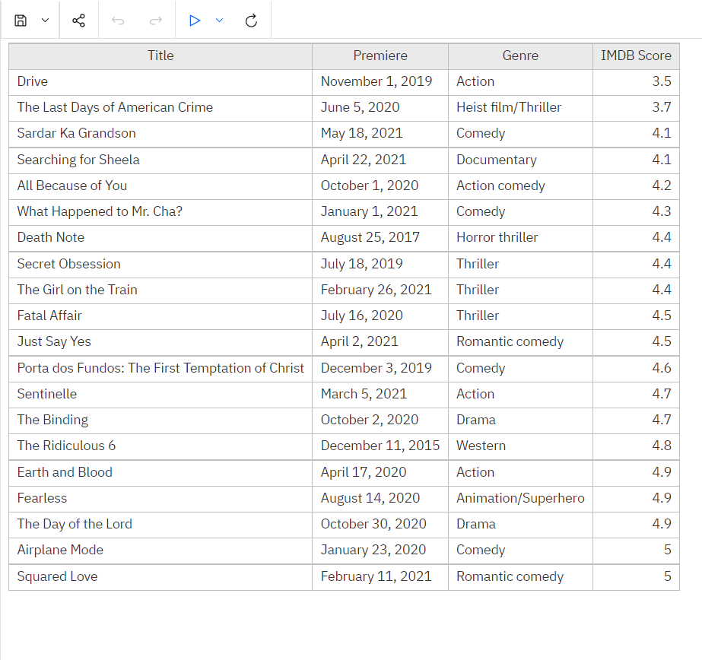
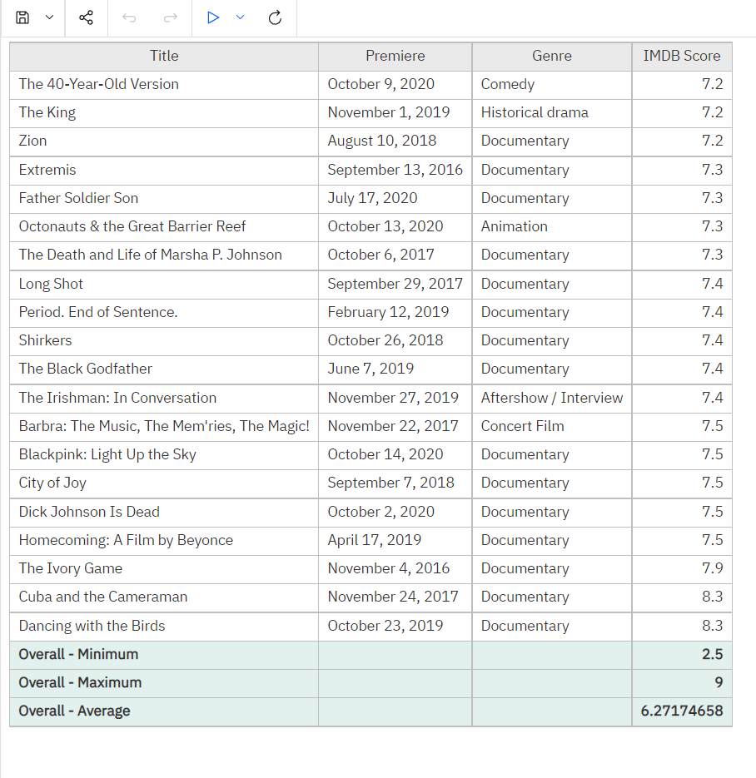
List Report [Imdb score of movies]

Slide 7
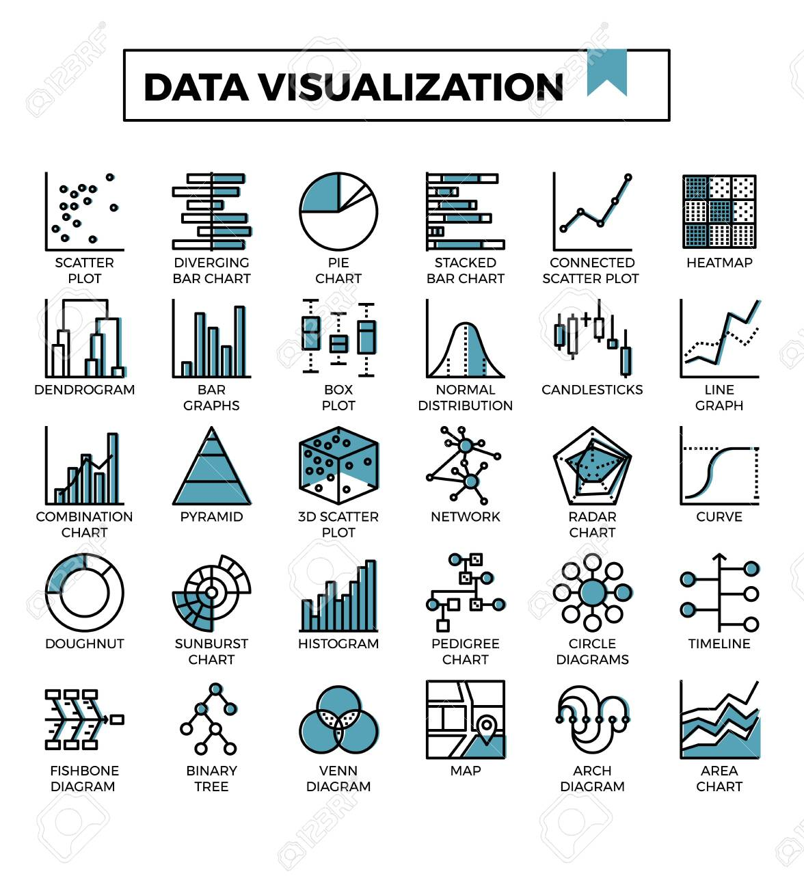
Visualization
2
Data visualization is the practice of translating information into a visual context, such as a map or graph, to make data easier for the human brain to understand and pull insights from. The main goal of data visualization is to make it easier to identify patterns, trends and outliers in large data sets.
Visualization

Slide 8
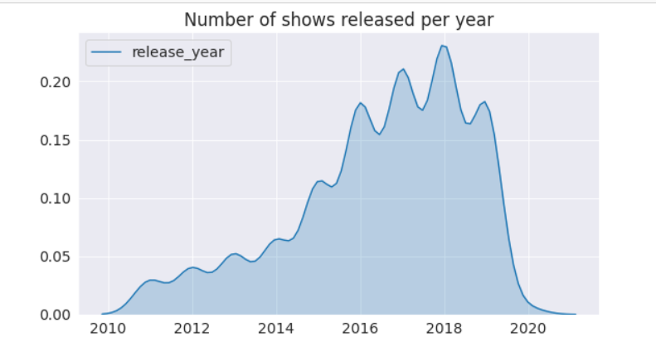
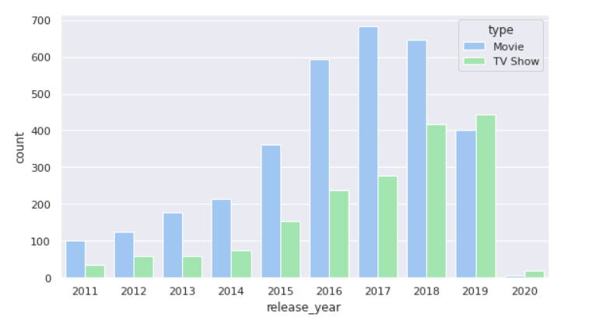
Frequency of release (2010-2020)

Slide 9
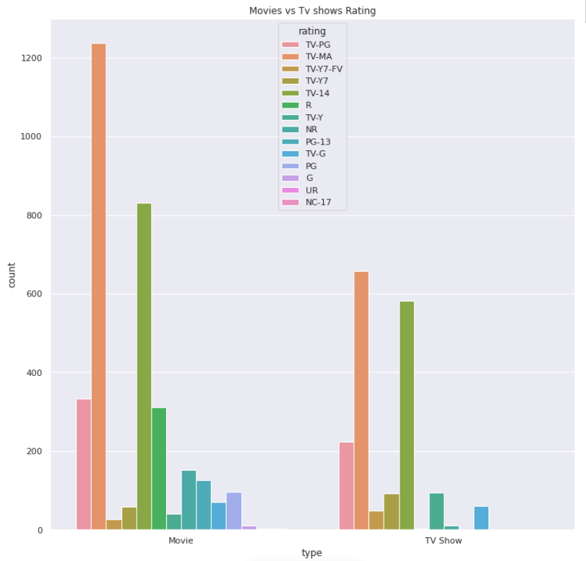
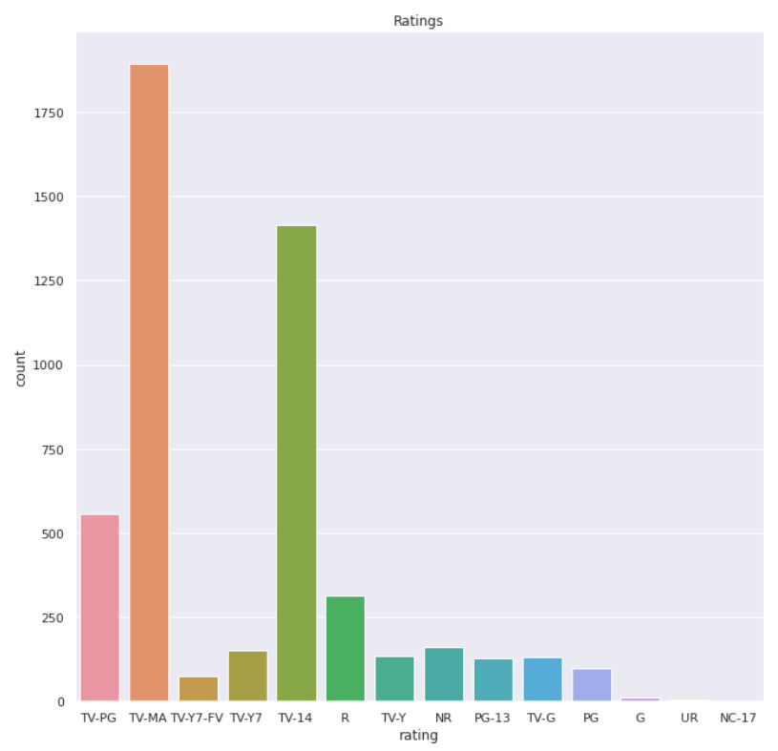
Types of shows and movies by rating

Slide 10
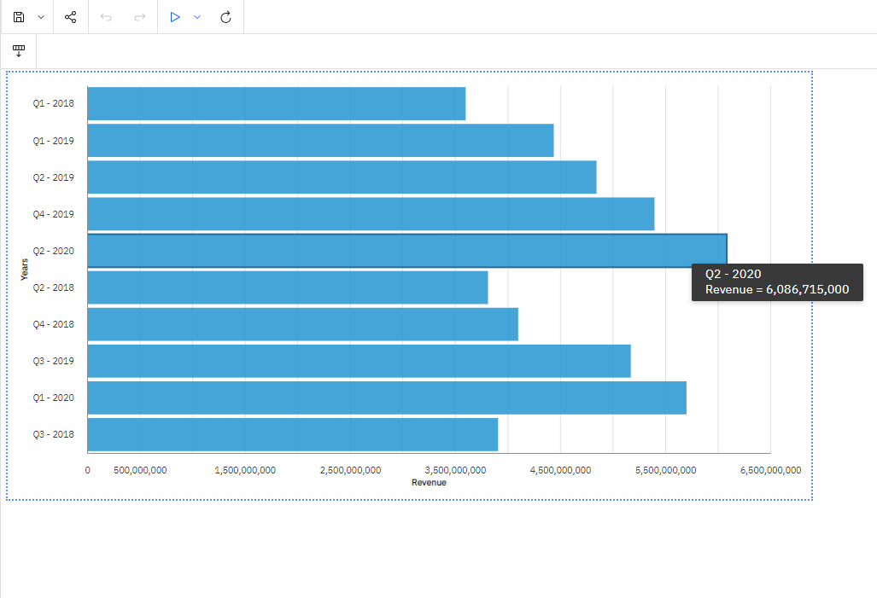
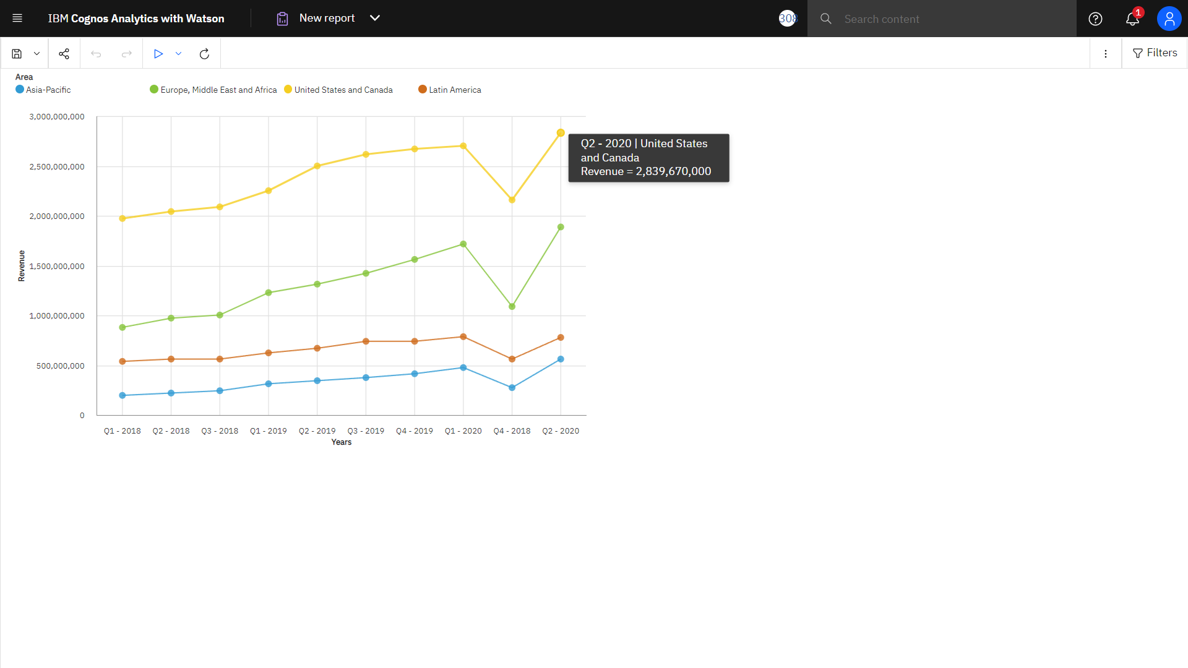
visualization [revenue (2018-2020)]

Slide 11

Crosstab
3
Cross tabulation is a method to quantitatively analyze the relationship between multiple variables. Also known as contingency tables or crosstabs, cross tabulation groups variables to understand the correlation between different variables. It also shows how correlations change from one variable grouping to another.
Crosstab

Slide 12
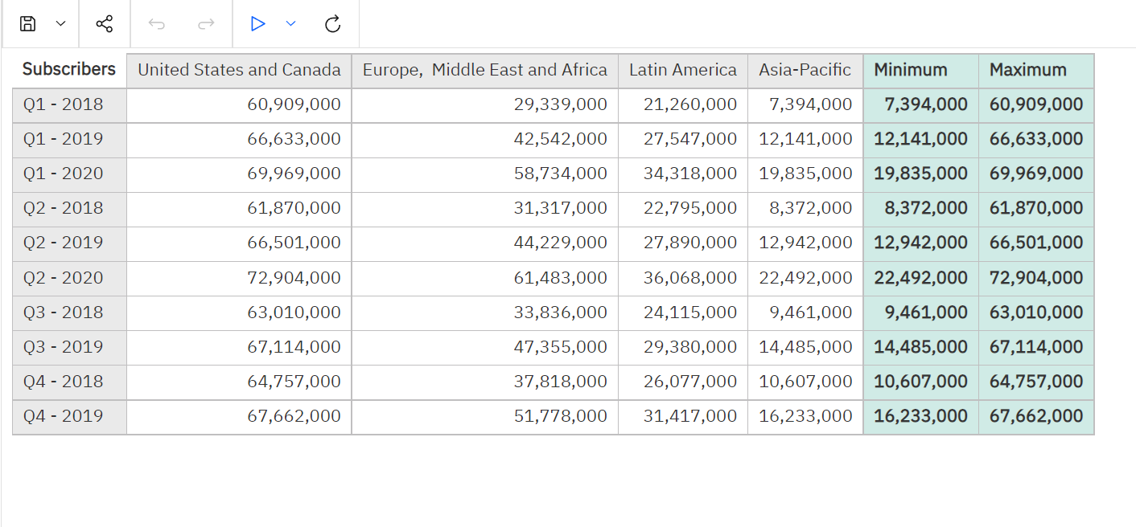
Crosstab [SUbscribers (2018-2020)]

Slide 13
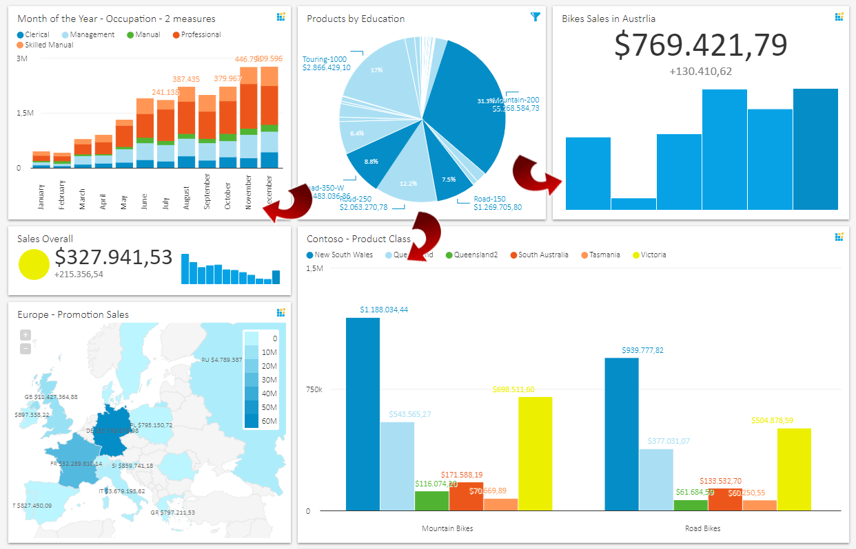
dashboard
4
A data dashboard is an analytics tool that visually displays, measures, and analyzes multiple data sources all at once. Common dashboards are typically interactive, provide historical & real-time data, and present all key performance indicators in one centralized location.
Dashboard

Slide 14
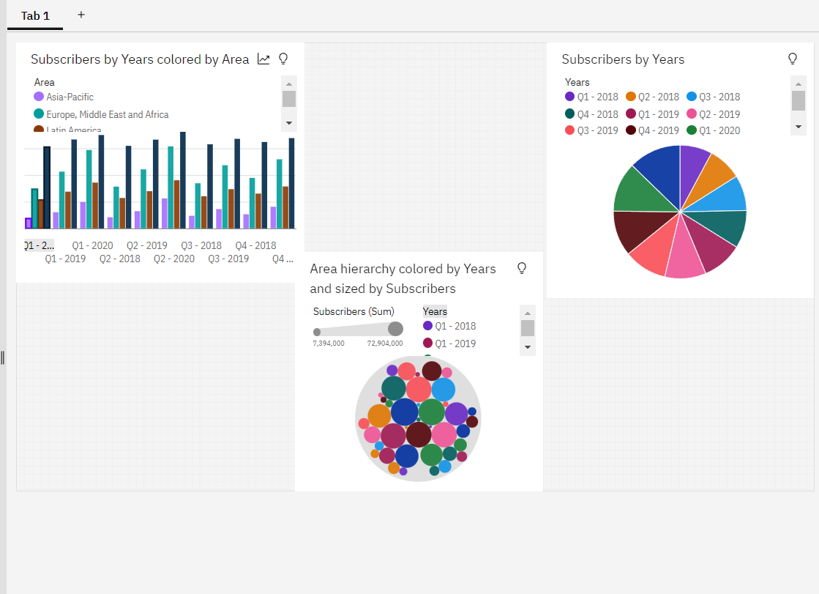
Dashboard [SUbscribers (2018-2020)]

Slide 15
THANK YOU
FOR LISTENING!
100% Done
19+
Presenter: Aman Khade(CSE-M Data Science)
20100BTCSDSI07258
Siddharth Mishra(CSE-M Data Science)
20100BTCSDSI07298
Subject: Descriptive Analytics
Teacher: Prof. Anmol Choudhary
Sign Out
Questions? Clarifications FAQ About Us Help Center

